Slide 1

Low Distortion Map Projections for Mars
Connor Derusseau

Slide 2
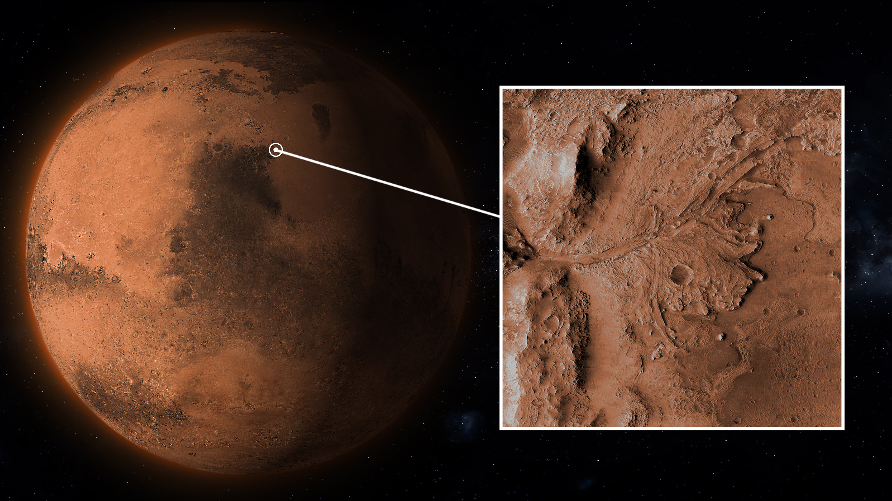
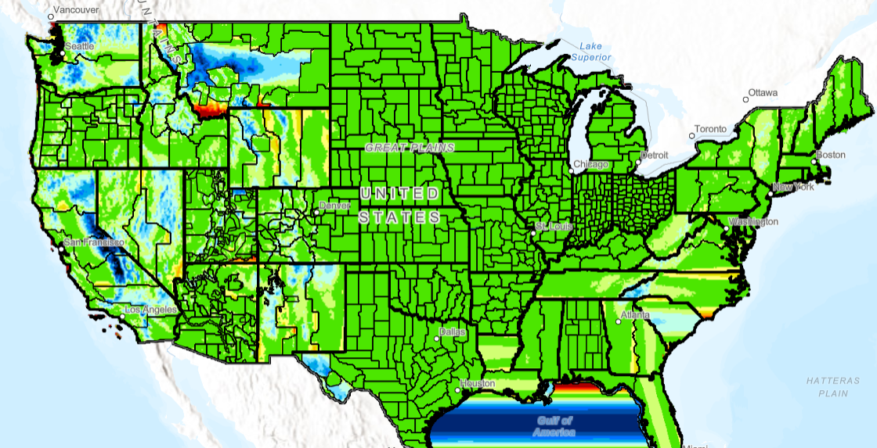
USGS State Plane Coordinate System
2. Applying State Plane Coordinate System to Mars
1. As human travel to mars becomes more likely, map projections made for engineering will be required
3. Accurate Maps
Notes:
As the reality of manned missions to mars creeps closer, maps more centric on engineering rather than the landing of rovers will be required. my project was to design map projections for engineering purposes to the surface of mars, which is new to the planet as a proof of concept. Utilizing the State Plane coordinate system, the goal was for the new map projections to reduce distortion at mars surface, therefore representing the ground more accurately. Jezero crater, pictured above, was chosen as the subject of these tests due to the recent expedition here by the perseverance rover, its range of topography, and its similarity to other high interest areas that may become future landing zones for astronauts.

Slide 3
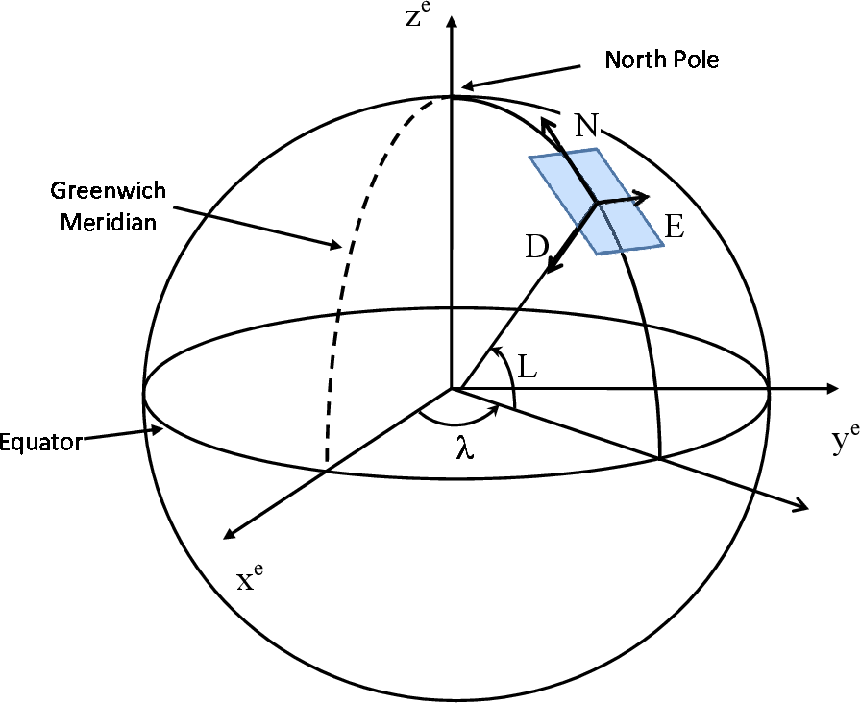
Outline
Types of map projections
Map projection distortion
Methods to reduce map projection distortion on mars
Final map projections
Extreme point comparison
Notes:
This is the overview of my presentation. Ill first start by exploring the different kinds of map projections, what they are, and their key differences. Then well look at how the map projections distort the ground surface of a chosen body. Using the project workflow to alter the map projection parameters, well evaluate the methods used to reduce the distortion present in my projections. a final map projection will be produced, which I will compare to the current map projections for Jezero crater. The figure on the right of this slide represents the parameters being changed to develop my map projections.

Slide 4
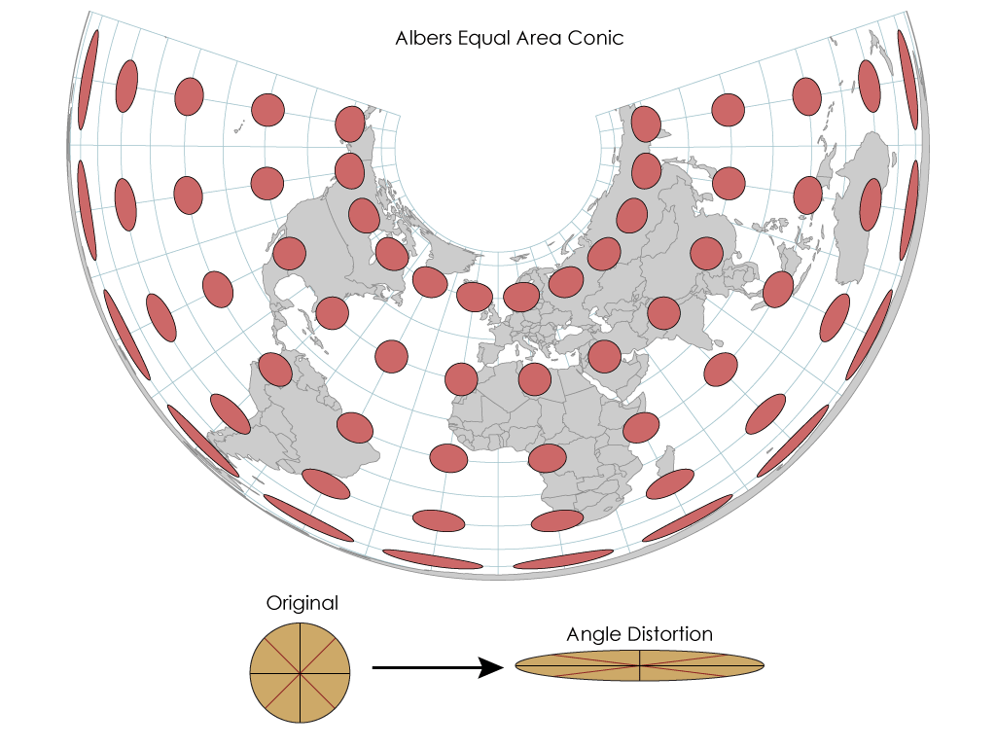
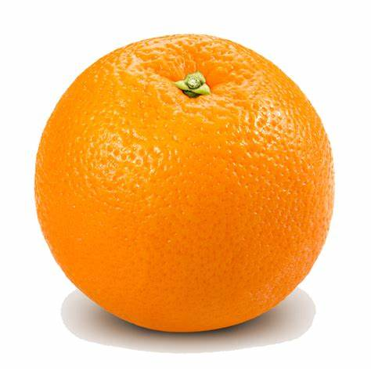
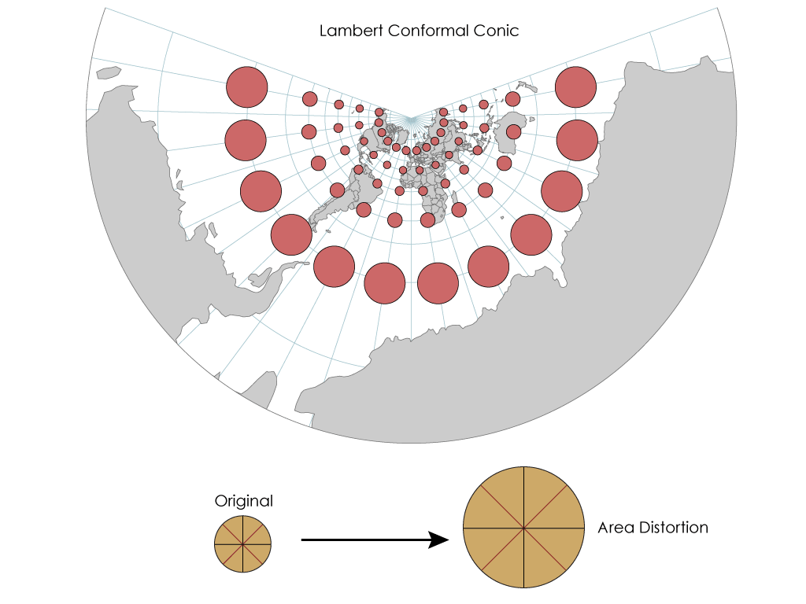
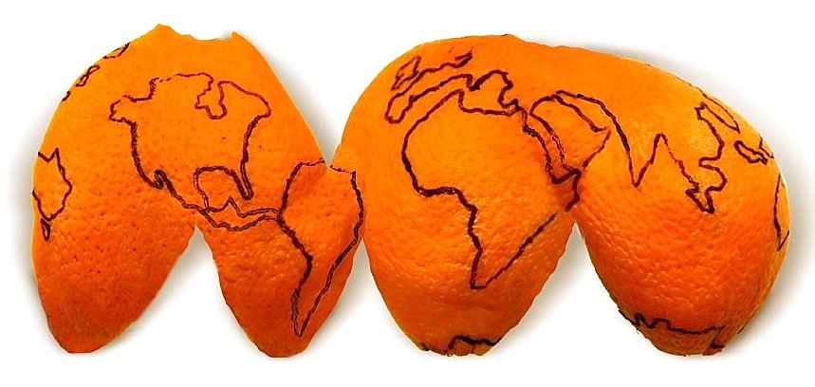
Conformal Map Projections
Preserve angles, distort distances and areas
Types of Distortion
Size
Shape
Distance
Direction
Notes:
The concept of map projection types can be represented by the orange peel problem. (The only way to lay it flat is to tear it) If we want to lay the orange peel flat, the only way this is possible would be to tear it. This version of a “map Projection” preserves the areas of the orange peel but would not be very good for locating and navigating due to the deforming of its angles. To combat this, the map projections we use are conformal, meaning they preserve the angles of an ellipsoid but can distort the distances and area. The map projections on the right are examples of these differences. The top is an equal area projection that distorts angles and the bottom is a conformal projection that distorts area. This is seen with the circles on the images, with the equal area map flattening and stretching the circles, and the conformal projection simply altering their size.

Slide 5
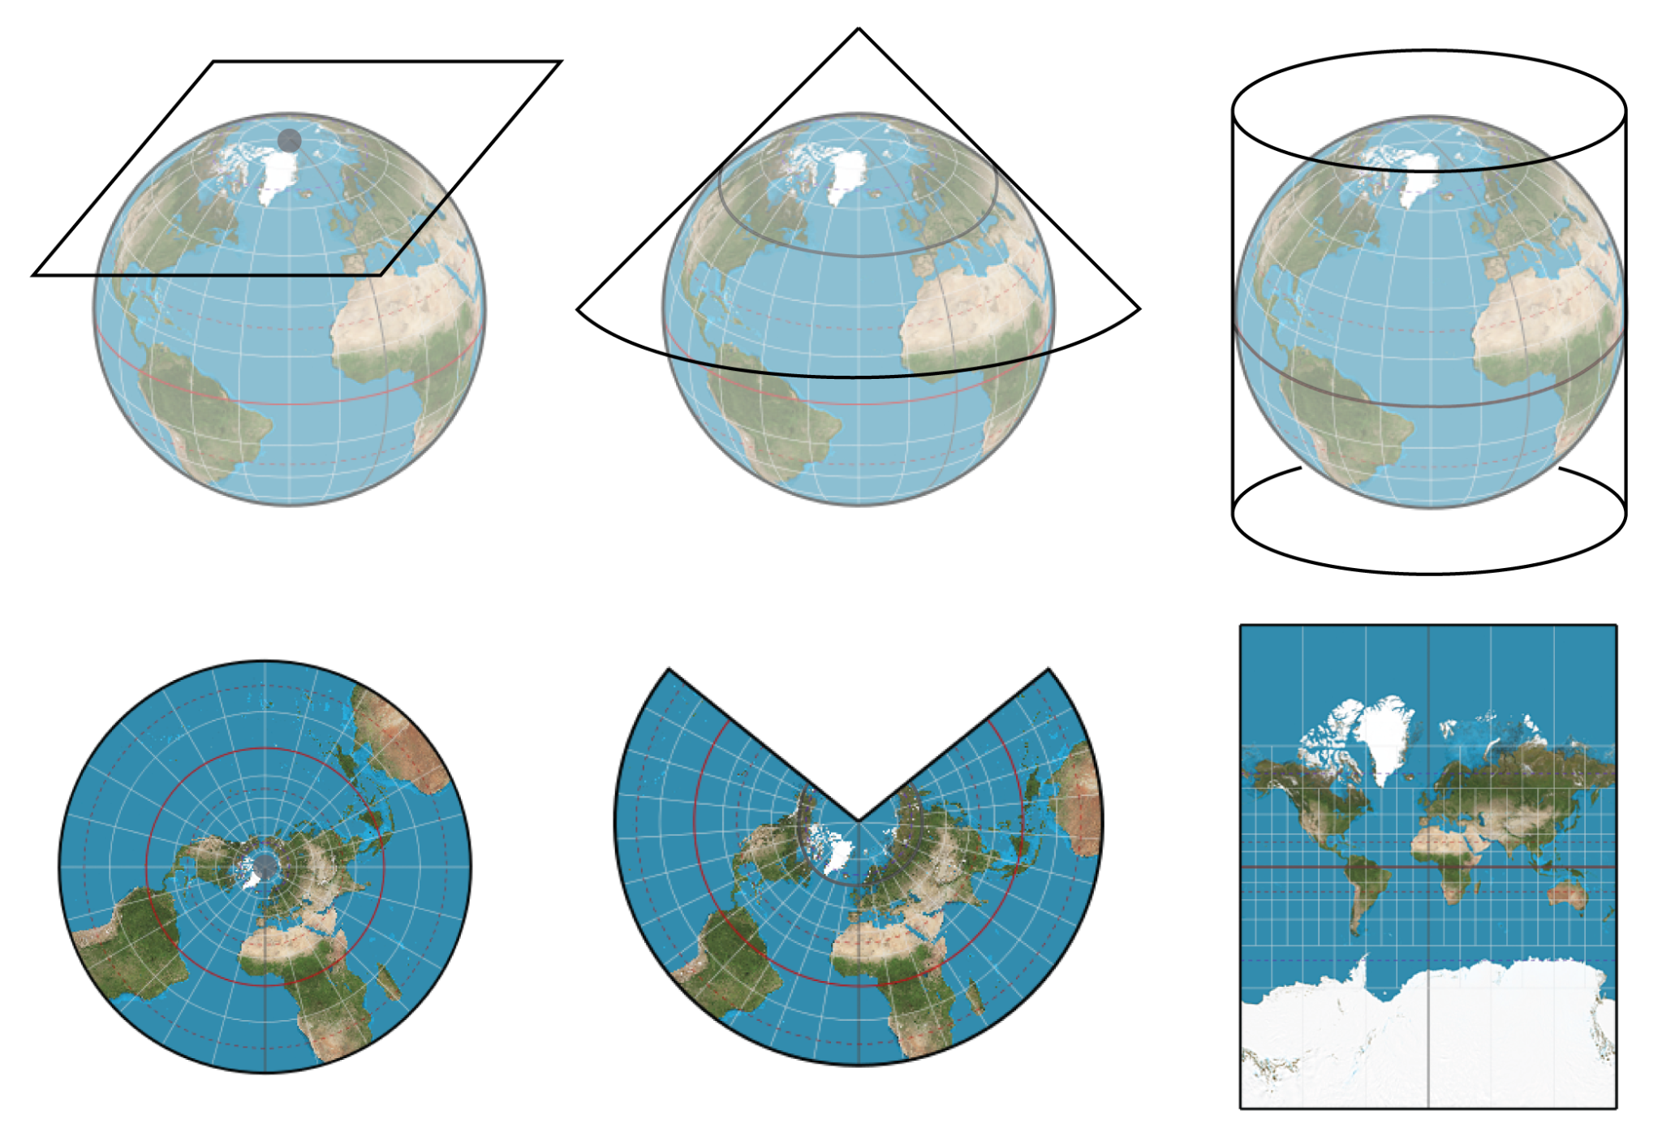
Map Projections
Planar
Conic
Cylindrical
Notes:
Above are three of the conformal map projections used In my project. We can picture these projections with the shapes above. Imagine laying, placing, or wrapping the associated shapes around the ellipsoid being projected, then plotting the points from the ellipsoid directly onto the shapes. These Map projections are on the surface of the ellipsoid being projected, and distortion is caused by how we represent the ground by plotting spherical coordinates on these flat surfaces.

Slide 6
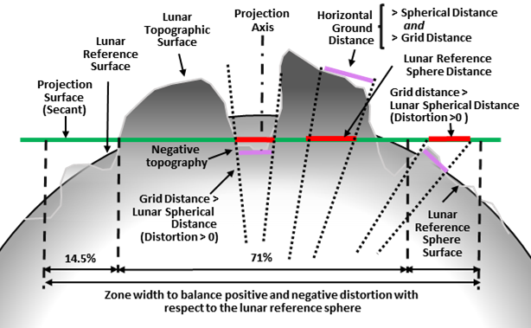
Grid-To-Ground Problem
Distances differ on the map and on the topographic surface
Total Distortion:
Sphere to flat map
3D topography to 2D map
Notes:
On a map projection, represented by the shapes on the last slide and the green line in this figure, area and distance is distorted compared to the ground. Topography lower and higher than the map projection causes the ground distance to be lesser or greater than the distance shown on the projection, which is shown by the purple and red lines on the map. The purple lines represent the true ground distance, while the red lines represent the distance on the projection. Distortion also occurs in the mathematics of plotting spherical data to a flat map. To combat this, the green line representing the map projection can be changed to match the surface better and thus reduce distortion.

Slide 7
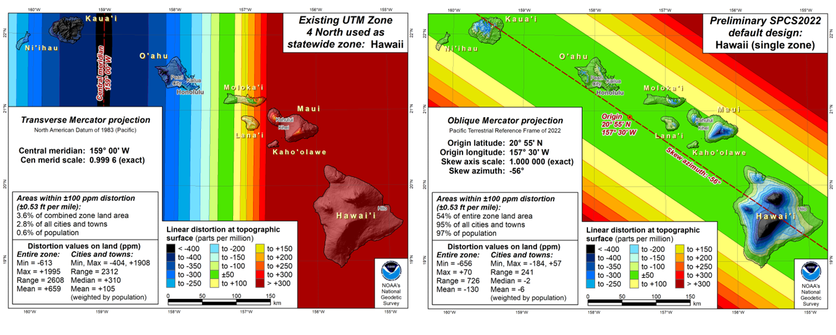
State Plane Coordinate System (SPCS)
Universal Transverse Mercator (UTM)
Oblique Mercator (OM)
Notes:
An earth analog to my project goals can be seen by comparing these two plots of the Hawaiian islands. The left plot is the islands with the Universal Transverse Mercator projection. This projection is used for navigation due to its large area covered. The plot on the right is the SPCS projection, utilizing a Oblique Mercator projection. This projection is used for engineering due to its much lower distortion at the ground. By prioritizing the small engineering designed zones, distortion range is significantly lowered for the target region. On earth, the target region are population centers. This means that for high use areas on these SPCS maps, the difference in distances on the map and on the ground are brought to a minimum.

Slide 8
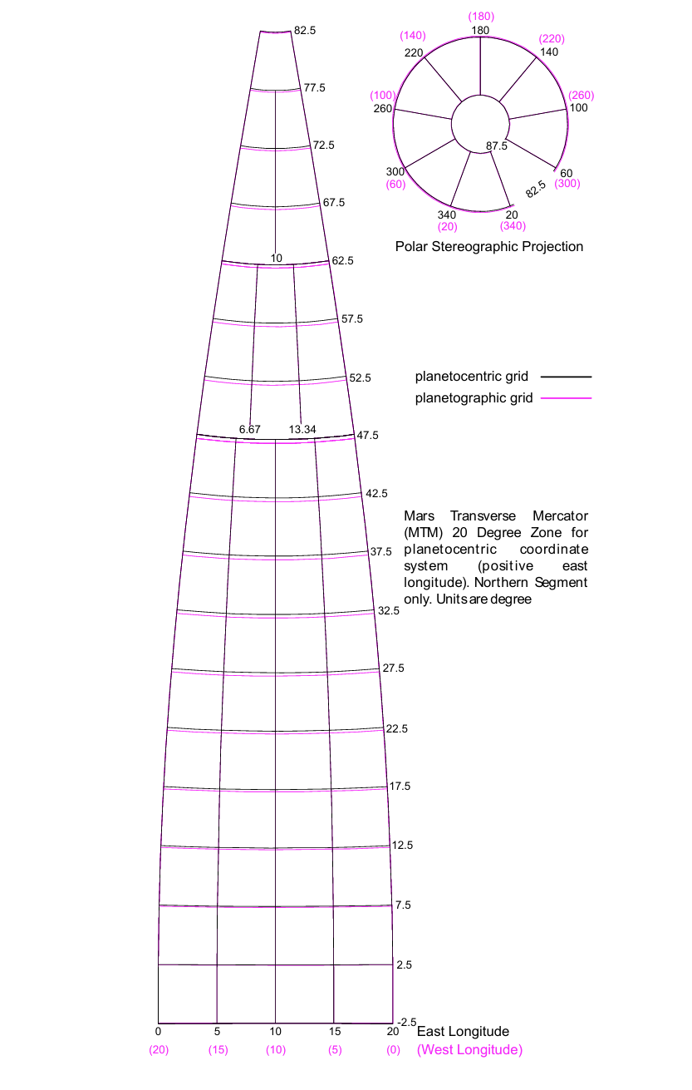
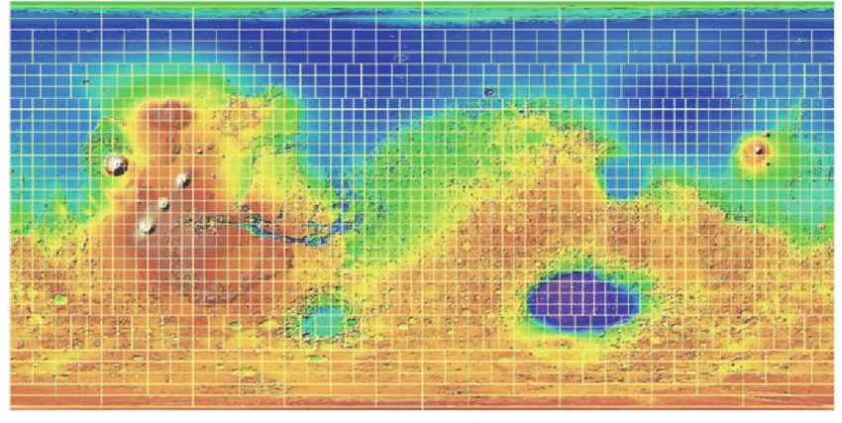
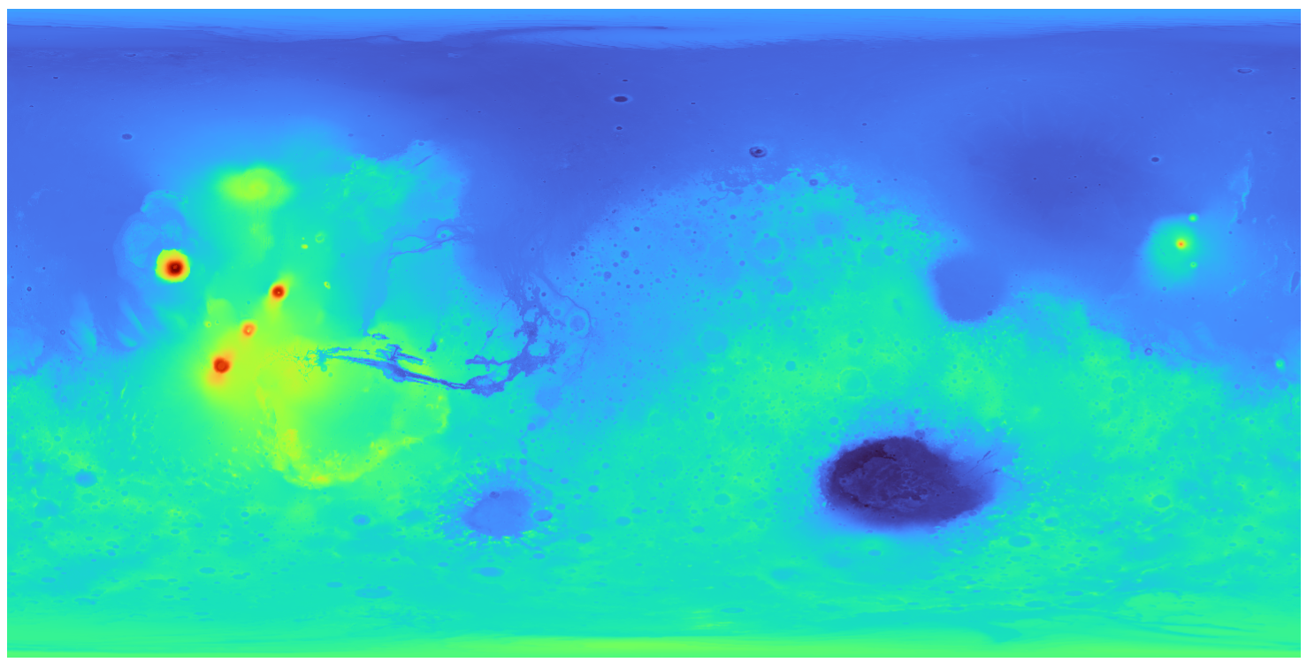
Mars Transverse Mercator (MTM) System Projection
Notes:
The current Mars map projection system is called the Mars Transverse Mercator. The projection subdivides mars into 18 20 degree zones and is planetocentric, meaning that longitude Is positive in the east direction. The MTM is a horizontally oriented cylindrical map projection. The distortion from this projection will be what I am comparing the data from my research to.

Slide 9
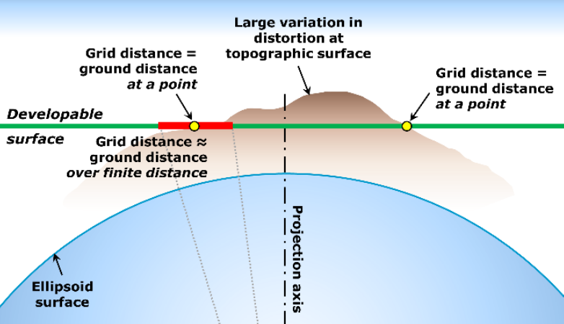
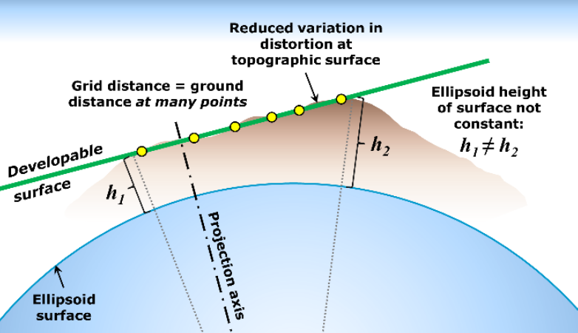
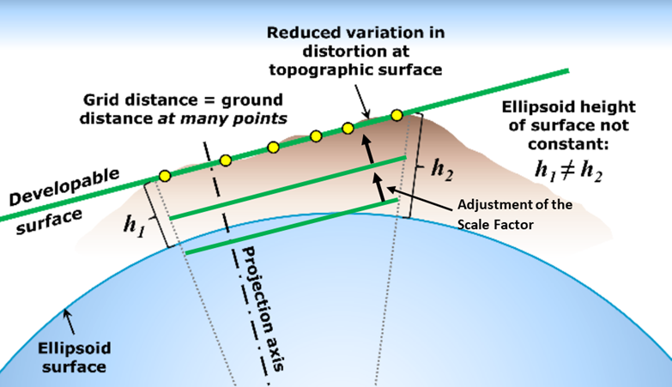
Methods
Steps
Goals
Source Elevation Data
Determine Masked Areas
Select Conformal Projection
Refine Projection Axis
Refine Scale Factor
Distortion within
+/-1 m:km
Balance distortion in region
Choose projection
Minimize distortion range
Scale to ground
Notes:
In order to produce a final design with minimum distortion, three main steps were taken in my research workflow. The first was to select a map projection, which is the developable surface in the figures. Then, I sought to reduce the range in the distortion of this projection by selecting a axis of origin that aligned the grid most optimally to the ground, like seen in the second figure. Finally, the scale factor was adjusted to move the projection grid further or closer to the ellipsoid in order to optimally distribute the distortion. The distortion is measurable and affects the map projections, and changing these parameters changes the distortion

Slide 10
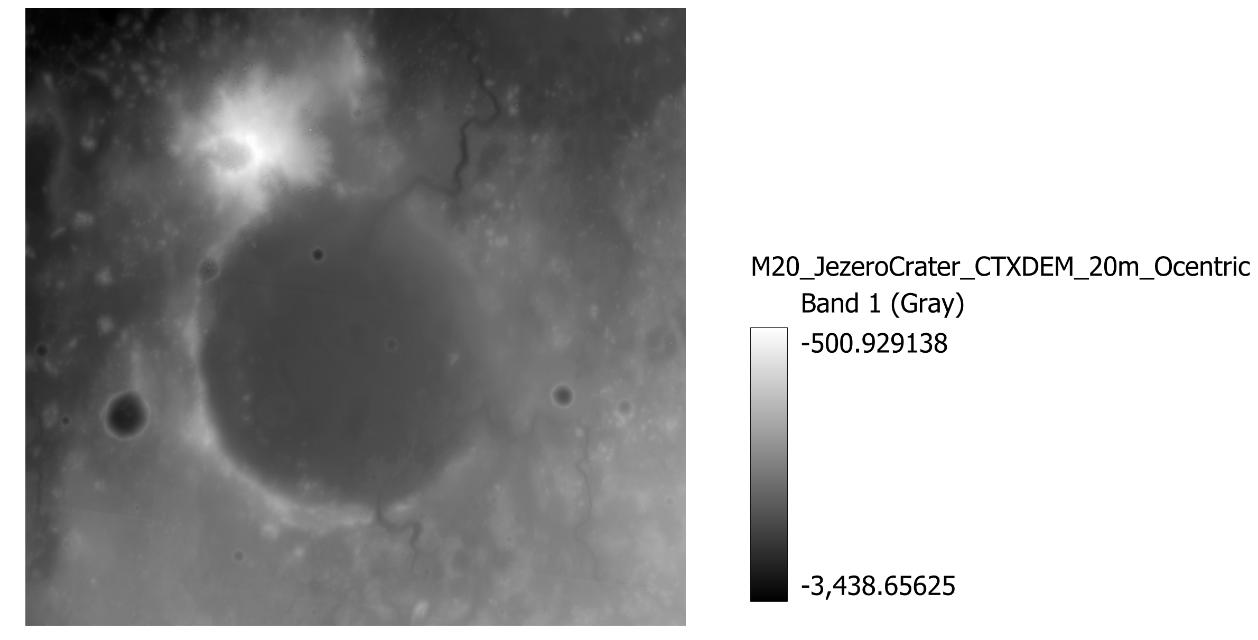
1. Source Elevation Data
Mars Elevation (meters)
m
Notes:
This is the Digital elevation data for Jezero crater. The crater is located on the northern hemisphere around 78 degrees latitude, and about 18 degrees from the prime meridian. This location is home to the perseverance rover and was chosen as a landing site because of the craters ability to potentially indicate past life on mars. A delta running from the crater could indicate water that flowed at some point in mars history. This date was collected by the Mars reconnaissance orbiter, and the elevation scale is in meters. Due to mars unique shape, even the mountainous region of Jezero crater is negative in elevation, with the highest elevation being about 501 meters below sea level and the lowest point being about 3439 meters below sea level.

Slide 11
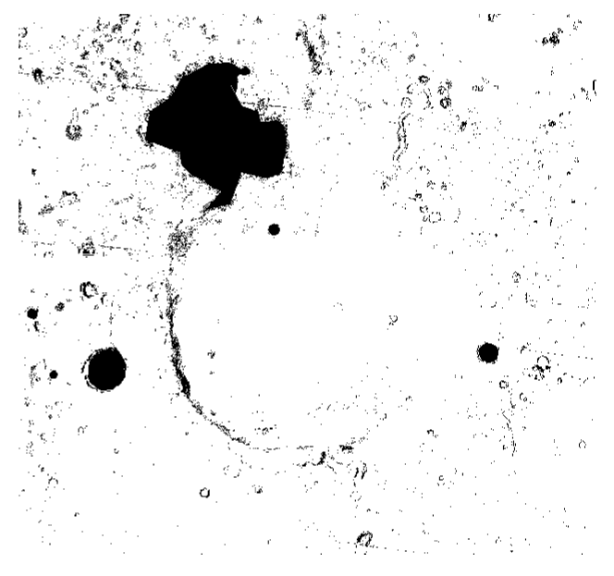
2. Determine Masked Areas
Slope >20° untraversable by astronauts & rovers
Black = no data
White = data valid
Notes:
As an extra processing step at the beginning of the workflow, I masked out areas of the map with a slope greater than 20 degress., such as the mountain on the northwest corner of the crater and the bottom of craters with slopes too steep to reach the bottom. this further reduces the range in distortion for the areas of the map that will actually be in use. The black pixels on the map represent masked out data, while the white pixels are valid data points.

Slide 12
3. Select Conformal Projection
Planar
Conic
Cylindrical
3 Projections
Lambert Conformal Conic (LCC)
Transverse Mercator (TM)
Oblique Mercator (OM)
OS, PS
LCC
TM, OM
Notes:
Of the projections shown earlier, the three projections I modeled distortion with were the conic and cylindrical projections. The best practice is to refine each map projection for the target area to pick the one with the lowest distortion, which is the one that represents the ground surface and the distance between points most accurately.

Slide 13
4. Refine Projection Axis
Goal: reduce distortion range
Align developable surface with topography
Notes:
To refine the projection axis, we find the origin axis that reduce the range in distortion to a minimum. The origin axis is the axis that the projection is created from. Looking at the way that distortion arises when projecting topography, a minimum can be found by picking an axis of origin that aligns the map grid the closest with the topography. Looking to the graph on the right, the range in distortion is heavily reduced when an axis off center with the projection is picked because the grid distance equals the ground distance at more points, compared to how one centered with the projection would fit. The green lines in these figures represent the shapes in the previous slide, so by changing the origin axis, we are changing the orientation of the shapes on the surface of mars.

Slide 14
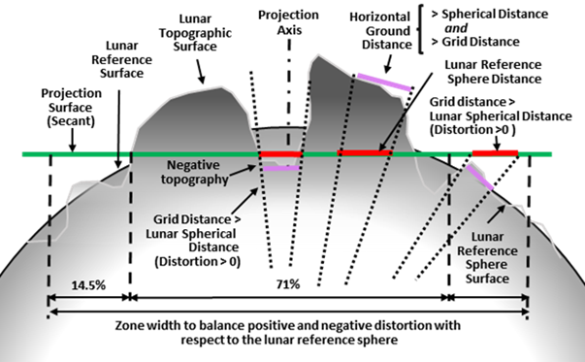
5. Refine Scale Factor
Goal: balance distortion
Scale Factor (k)
Scale to ground
Scale Factor = ratio of distances on mars to distances on map
Notes:
The Final step to the process is to determine a scale factor for the projection. Looking to the figures, scale factor determines the height from the ellipsoid that the developable surface occupies. The goal is to find a scale factor that optimally distributes the range of distortion about even scale by moving the surface closer or farther from the ellipsoid. (scale factor is warping shapes shapes to the surface)

Slide 15
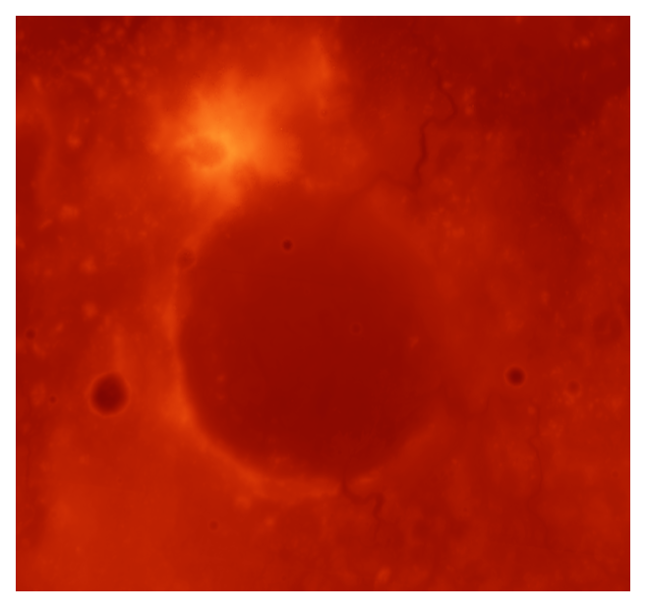
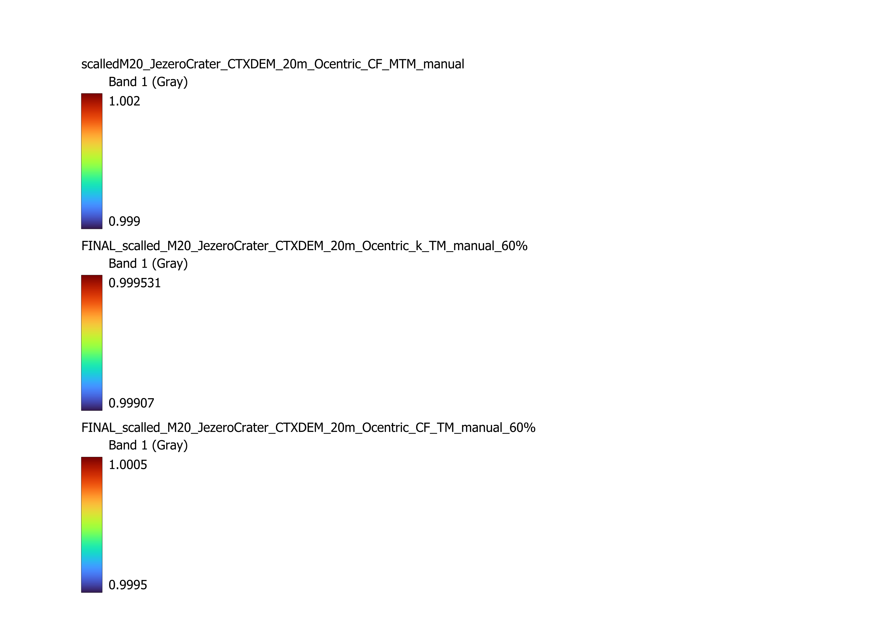
MTM Linear Distortion
Linear Distortion Range (m:km)
Range | 0.000827909 82.8 cm:km
Max | 1.0013666 1.37 m:km
Min | 1.0005387 53.9 cm:km
Goal: +/- 1 m:km
Notes:
The data plotted here is the distortion for the unoptimized MTM projection. As you can see, the distortion is heavily distributed above 1, from 1.0005 to 1.0014 These measurements are in scale. This means that values above and below one are the distance distortion per meter. Simplifying this, a value of one thousandth is equivalent to 1 meter per kilometer. In more conventional terms, the range for this projection is 82.8 centimeters per kilometer. This MTM projection then has an average distortion around plus one meters per kilometer, and a range of about 82.8 centimeters per kilometer.

Slide 16
Parameters
Linear Distortion Range (Scale)
Goal: +/- 1 m:km
Notes:
These are the projection parameters for the three projections tested in the previous slide. The Longitude and Latitude values were determined running a python script that calculated the range of distortion for a range of different longitudes and latitudes and returning the angles that had the lowest distortion. The scale factor for each projection was determined by running a similar script that returned the factor values based on the percent area with positive distortion. Combining these data points, I selected the 60% Transverse Mercator projection as the ideal projection for the Jezero crater area because it minimized the range in data and balances the distortion.

Slide 17
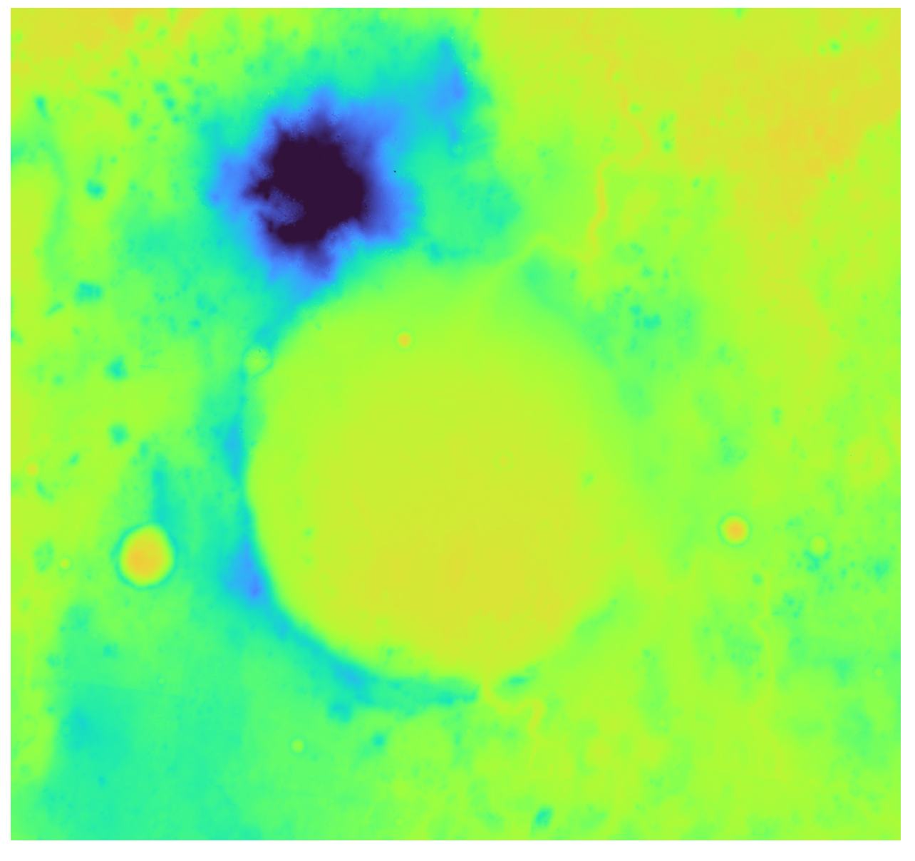
Masked Linear Distortion Transeverse Mercator (PPM)
1
2
Linear Distortion Range (Scale)
Projection | range | Max | Min
TM | 0.000814855 81.5 cm:km | 1.0001348 13.5 cm:km | 0.99932 -68.0 cm:km
LCC | 0.000891745 89.2 cm:km | 1.0001729 17.3 cm:km | 0.9992811 -71.9 cm:km
OM | 0.000815451 81.5 cm:km | 1.0001353 13.5 cm:km | 0.99931985 -68.0 cm:km
3
5
4
Goal: +/- 1 m:km
Notes:
The data represented here is my refined map projection for Jezero crater. The Oblique Mercator and Transverse Mercator projections possessed much more desirable distortion ranges than Lambert Conformal Conic, which could be because of Jezero Craters location on mars or its negative elevation. The Transverse Mercator projection had the best distortion range being 81.5 cm per kilometer only about half a centimeter better than the Oblique Mercator projection.

Slide 18
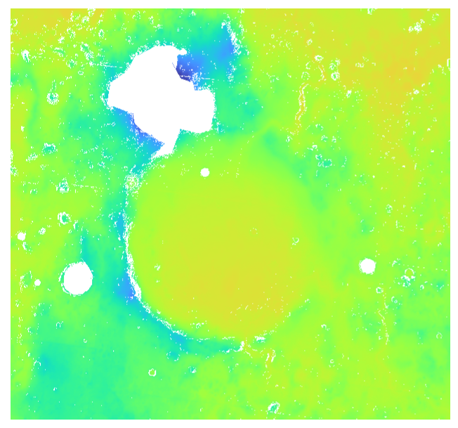
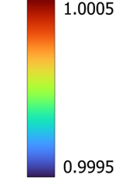
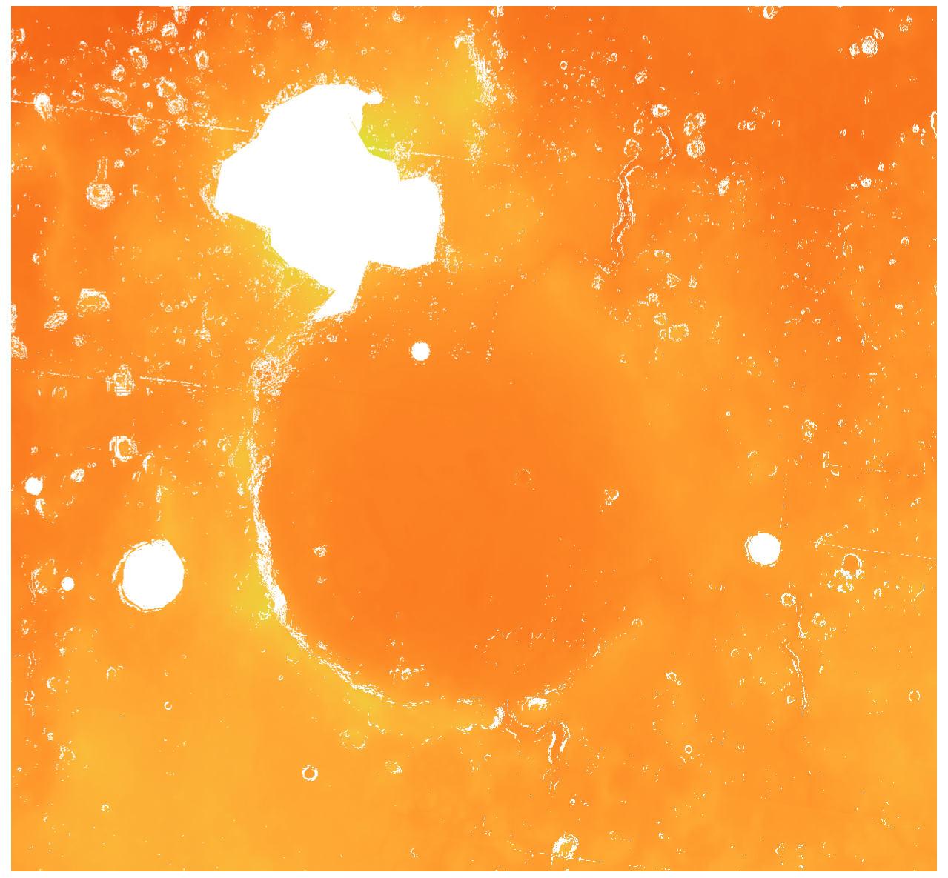
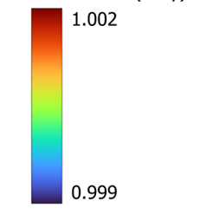
Extreme Point Comparison
Optimized Zone
Extreme Point Comparison to Masked Interoperability Regions
Masked SPCS Zone (TM)
Min | Max | Range
0.9995613098 -43.9 cm:km | 1.0001161098 11.6 cm:km | 0.0005548 55.5 cm:km
Mars Transvers Mercator (MTM)
Masked MTM Zone
Min | Max | Range
1.0007327 73.3 cm:km | 1.0013655 136.6 cm:km | 0.0006328821 63.3 cm:km
range improvement: 7.8 cm:km
Notes:
Compared to the MTM projection, my projection did reduce the range in distortion from 63.3 cm per kilometer to 55.5 cm to kilometer. This shows that the SPCS concept can be applied to mars to reduce the distortion at these high interest locations. Additionally, the distribution of distortion was heavily improved with the SPCS projections, with the average distortion value and area with positive distortion being negative 4 mm per kilometer and 60% for my projection compared to 1.1 meters per kilometer and 100% for the MTM projection. Ultimately, the goals for a new map projection were met as the Transverse Mercator projection does fall well within plus and minus 1 m per kilometer and reduces the range in distortion values.

Slide 19
Thank you!
Notes:
I learned a lot from this experience, Many thanks to NAU and

Slide 20
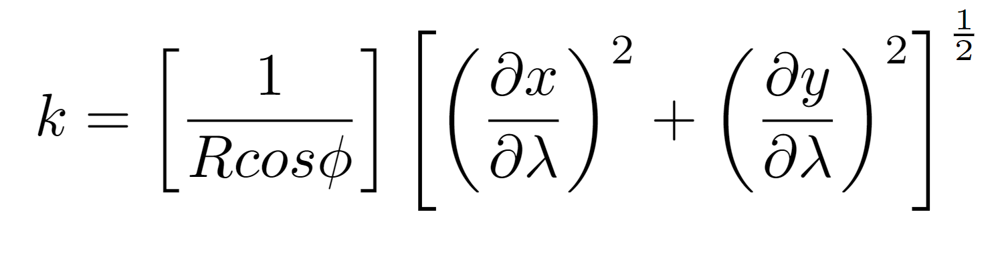
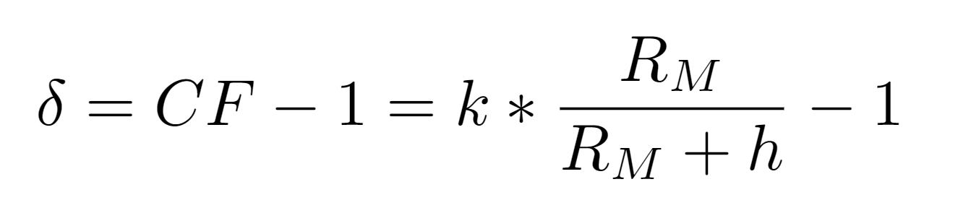
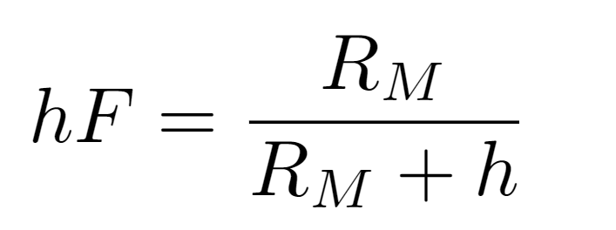
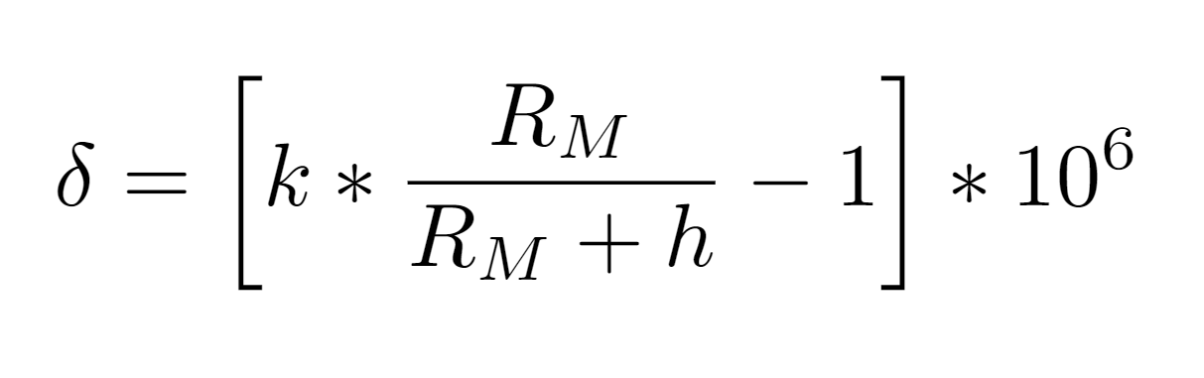
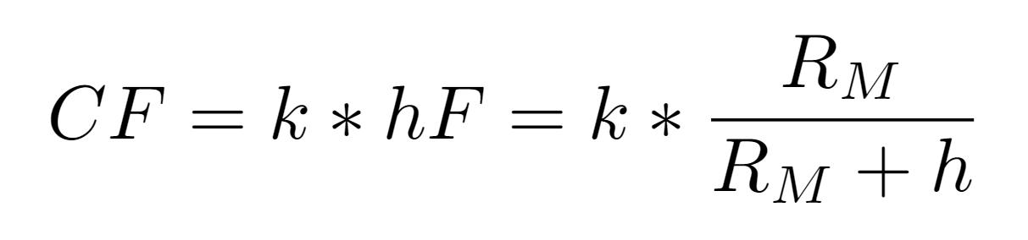
Equations
Scale Factor
Linear Distortion
Height Factor
Linear Distortion in PPM
Combined Factor

